Slide 1
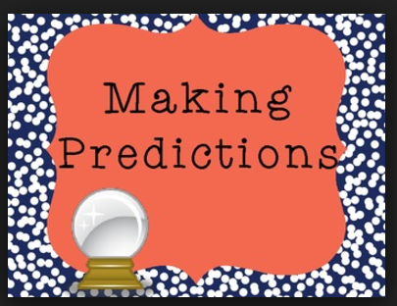
STUDENT BEHAVIOUR PREDICTION

Slide 2
ABSTRACT
Data mining is the technique that can be directed to support the specific need of each of the participants in the education system and the process.
Right now there are so many prediction systems are available with difference approach and techniques in student performance prediction that has been reported by researcher.
The knowledge is hidden among the educational datasets that is extractable through data mining techniques. This paper designed to clarify the capability of data mining techniques in the context of lower education to higher education in university or other educational system by taking in mind different approaches.
In this research, the classification task is use to evolved student performance and there are so many approaches to figure out the performance of student. By this different method we can extract knowledge that describes student performance, It definitely helps to improve the performance of student.

Slide 3
TECHNIQUES USED
1.CLASSIFICATION
SVM:
In machine learning, support vector machines (SVM) are supervised learning models with associated learning algorithms that analyse data used for classification and regression analysis. Given a set of training examples, each marked as belonging to one or the other of two categories, an SVM training algorithm builds a model that assigns new examples to one category or the other, making it a non-probabilistic binary linear classifier (although methods such as Platt scaling exist to use SVM in a probabilistic classification setting).
An SVM model is a representation of the examples as points in space, mapped so that the examples of the separate categories are divided by a clear gap that is as wide as possible. New examples are then mapped into that same space and predicted to belong to a category based on which side of the gap they fall.
In addition to performing linear classification, SVMs can efficiently perform a non-linear classification using what is called the kernel trick, implicitly mapping their inputs into high-dimensional feature spaces.

Slide 4
2. CLUSTERING:
Clustering is finding groups of objects such that the objects in one group will be similar to one another and different the objects in another group . In educational area, clustering will be used to grouping students according to their behaviour and performance. In this study we used simple K-means algorithm to cluster the given data.
K-means is one of the simplest unsupervised learning algorithms that solve the well known clustering problem.
The procedure follows a simple and easy way to classify a given data set through a certain number of clusters (assume k clusters) fixed apriori. Finally, this algorithm aims at minimizing an objective function know as squared error function.

Slide 5
KEYWORDS:
Student performance, educational data mining, performance prediction
PROPOSED WORK:
Educational data mining is the emerging field regarding to prediction of future performance. The objective of the proposed methodology is to build the classification model that classifies a student’s performance and has been built by combining the Standard Process for Data Mining that includes: business understanding, data understanding, data preparation, modelling and finally application of data mining techniques which is classification in present study. Particularly, we will implement the rules into SOM algorithm to predict the students’ final grade. Also we clustered the student into group using kernel k-means clustering. This study expressed the strong correlation between mental condition of student and their final academic performance. Data Mining Technique has a potential in performance monitoring of universities and other levels education offering historical perspectives of students’ performances. The results may both complement and supplement tertiary education performance monitoring and assessment implementations.

Slide 6
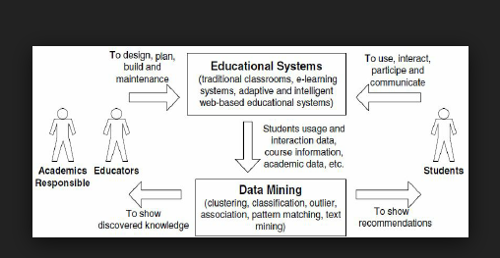
ARCHITECTURAL DESIGN

Slide 7
EXPERIMENTAL RESULT :
The proposed work we are going to create a prediction System by using two algorithms k-means & SVM for this we need to generate future vector from the row datasets in the form of clusters.
Following procedure followed for the analysis of proposed Solution: The row Datasets of the student is obtained for the processing It undergoes the cleaning Procedure.
Clustering algorithm is applied on the data, while the row data is also maintained.

Slide 8
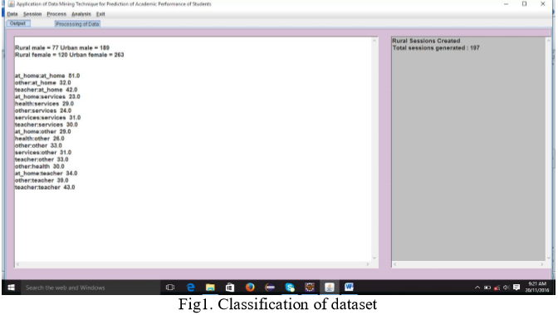

Slide 9
Classification algorithm is applied on clusters to generate the iterations by using this classification on sorted data set we can analysis the prediction of student performance.
K-means Clustering

Slide 10
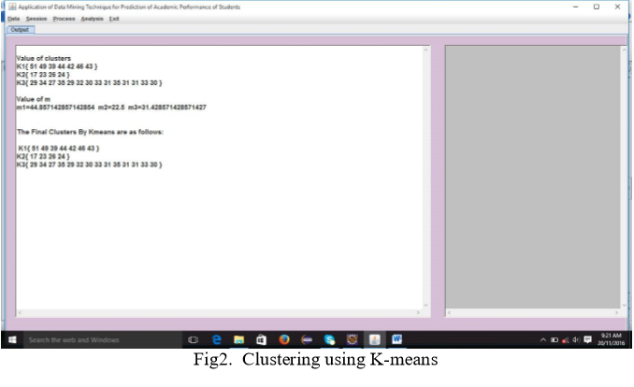

Slide 11
Final Data Analysis:
We can decide what are the factors influencing students grade.
We are able to predict the student behaviour and take necessary precautions.

Slide 12
CONCLUSION :
The classification task is used on student database to predict the students grade on the basis of data set.
As there are many approaches that are used for data classification. Information’s like Attendance, Class test marks, about parents were collected from the students previous database, to predict the performance at the end of the semester.
This study will help to the students and the teachers to improve the grade of the student.
This study will also work to identify those students which needed special attention to reduce fail ration and taking appropriate action for the next semester examination.

Slide 13
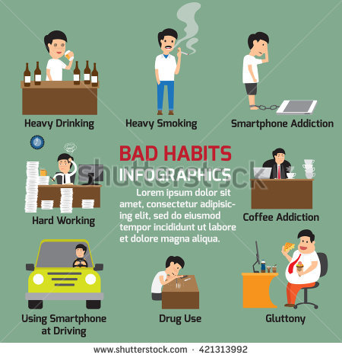

Slide 14
BY
Y.MANASA(411582)
M.SHUSHMA(411545)
Y.LAKSHMI SRAVANTHI(411583)

